Slide 1
This is my father’s world
Do your own research,
Come to your own conclusions
Suggested books:
The Ark on Ararat, Tim LaHaye and John Morris
Tornado in a Junkyard, James Perloff
The Genesis Record, Henry Morris
Suggested websites:
www.godandscience.org www.ldolphin.org/daysofpeleg.pdf www.setterfield.org/Genesis1-11/part_13_Peleg
Notes:
Psalm 104:6, terraforming

Slide 2
This is my father’s world
The story of
BABEL
How Human Societies Developed
Notes:
Evolutionists have to explain not just how man evolved, but how he did it all over the world at right about the same time

Slide 3
Ancient man
From the beginning man was to “fill the earth, and subdue it” (Genesis 1:28)
Quickly man learned to cultivate the ground and tend animals (Genesis 4:2)
“Implements of bronze and iron” (Genesis 4:22) developed quickly
The flood destroyed almost all ancient technology, forcing man to begin again
Notes:
It began with God
It was formed by God
It was revealed through God
It was subjected to God

Slide 4
Nimrod’s accomplishments
Built two world empires (Genesis 10:10-11)
Invented urban industry (Genesis 11:3)
Invented city walls and warfare
Invented the “major attraction”
Tried to subvert God’s plan for man to again “fill the earth” (Genesis 9:1)
Notes:
It began with God
It was formed by God
It was revealed through God
It was subjected to God

Slide 5
God’s response
Confused the languages in the third (Genesis 11:6-7) or even second (Genesis 10:5) generation from Noah
“Divided” the earth in the fifth generation from Noah (Genesis 10:25)
Babel’s scattering may have been compounded by physical restructuring of the earth (Job 38:25, Psalm 55:9)
Notes:
It began with God
It was formed by God
It was revealed through God
It was subjected to God

Slide 6
Man’s response
The patriarchs’ grandchildren were scattered while Noah was still alive
  Peleg was born 101 years after the flood
  Noah lived another 249 years (Genesis 9:28), Shem another 399 (Genesis 11:11)
  Noah saw every generation up to Abram
Technology re-emerged gradually
Ancient stories became mythologized
Notes:
It began with God
It was formed by God
It was revealed through God
It was subjected to God

Slide 7
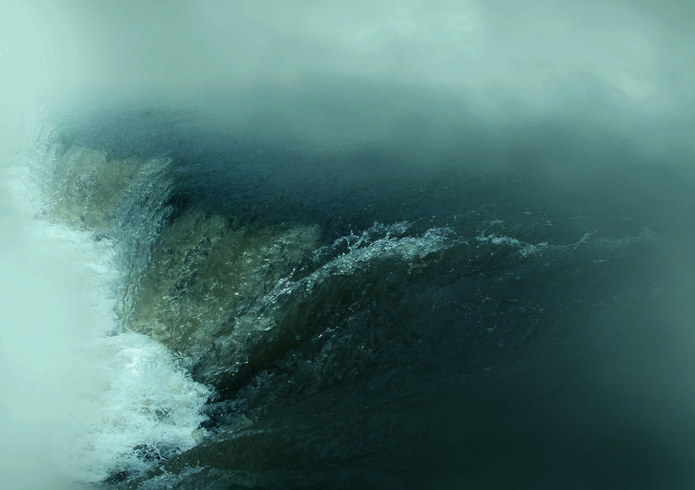
The Bible flood story
The world was wicked (Genesis 6:5)
Noah was righteous (Genesis 6:8)
Noah built an ark (Genesis 6:14)
He saved his household (Genesis 7:1)
He took animals in pairs (Genesis 7:2)
It rained for 40 days and nights (Genesis 7:4)
He sent out a dove to check the water levels (Genesis 8:8)
Notes:
What is evil? Terrorism, injustice, inequity, meanness

Slide 8
“Mythologized” versions
95 percent – flood was worldwide
88 percent – one family was favored
70 percent – saved by means of a boat
67 percent – animals also saved
66 percent – flood was a result of man’s wickedness
57 percent – the survivors wound up on a mountain
35 percent – birds were sent out from the boat
9 percent – exactly eight people were saved
Notes:
What is evil? Terrorism, injustice, inequity, meanness

Slide 9
The Hawaiian
Flood Legend
“Long after the death of Kuniohonna, the first man, the world became a wicked, terrible place to live. There was one good man left; his name was Nu-u.
“He made a great canoe with a house on it and filled it with animals. The waters came up over all the earth and killed all the people. Only Nu-u and his family were saved.”
-- Dinosaurs by Design, Duane Gish, pg. 74

Slide 10
The “Hihking”
“One ancient Chinese classic called the “Hihking” tells the story of Fuhi, whom the Chinese consider to be the father of their civilization. This history records that Fuhi, his wife, three sons, and three daughters escaped a great flood. He and his family were the only people left alive on earth. After the great flood they repopulated the world.
“An ancient temple in China has a wall painting that shows Fuhi’s boat in the raging waters. Dolphins are swimming around the boat and a dove with an olive branch in its beak is flying toward it.”
-- Dinosaurs by Design, Duane Gish, pg. 74

Slide 11
The Miao flood legend
So it poured 40 days in sheets and in torrents,
Then 55 days of misting and drizzle.
The waters surmounted the mountains and ranges,
The deluge ascending leapt valley and hollow. …
But the Patriarch Nuah was righteous,
The Matriarch Gaw-Bo-lu-en upright,
Built a boat very wide,
Made a ship very vast.
Their household entire got aboard and were floated,
The family complete rode the deluge in safety.
Notes:
What is evil? Terrorism, injustice, inequity, meanness

Slide 12
The Miao flood legend
The animals with him were female and male.
The birds went along and were mated in pairs.
When the time was fulfilled, God commanded the waters,
The day had arrived, the flood waters receded.
Then Nuah liberated a dove from their refuge,
Sent a bird to go forth and bring again tidings.
The flood had gone down into lake and to ocean;
The mud was confined to the pools and the hollows.
There was land once again where a man might reside;
There was a place in the earth now to rear habitations.
Notes:
What is evil? Terrorism, injustice, inequity, meanness

Slide 13



Lessons in Chinese
Mouth (person)
Boat
Eight
Ark
(Eight people on a boat)
Notes:
Evil serves His purposes – bringing down other evildoers, increase dependence on Him, increase longing for heaven, remind of sin’s consequences
Give us something to do, strengthen faith, gives opportunity to repent
Not a long-term plan – evil will be eradicated soon
What would you have Him do in the meantime? Eradicate sinners (Boanerges)? Rob of free will? Make this life more pleasant

Slide 14


Lessons in Chinese
Mouth (person)
Alive
Dirt, clay
To speak
(living person from dirt)
Notes:
Evil serves His purposes – bringing down other evildoers, increase dependence on Him, increase longing for heaven, remind of sin’s consequences
Give us something to do, strengthen faith, gives opportunity to repent
Not a long-term plan – evil will be eradicated soon
What would you have Him do in the meantime? Eradicate sinners (Boanerges)? Rob of free will? Make this life more pleasant

Slide 15

Lessons in Chinese
Man
Alive
Dirt, clay
First
(man living from dirt)
Notes:
Evil serves His purposes – bringing down other evildoers, increase dependence on Him, increase longing for heaven, remind of sin’s consequences
Give us something to do, strengthen faith, gives opportunity to repent
Not a long-term plan – evil will be eradicated soon
What would you have Him do in the meantime? Eradicate sinners (Boanerges)? Rob of free will? Make this life more pleasant

Slide 16


Lessons in Chinese
Man
Alive
Garden
Secret
Devil
(Secret man alive
in a garden)
Notes:
Evil serves His purposes – bringing down other evildoers, increase dependence on Him, increase longing for heaven, remind of sin’s consequences
Give us something to do, strengthen faith, gives opportunity to repent
Not a long-term plan – evil will be eradicated soon
What would you have Him do in the meantime? Eradicate sinners (Boanerges)? Rob of free will? Make this life more pleasant

Slide 17


Lessons in Chinese
Man
Alive
Garden
Secret
Cover
Tempter
(The devil, under the cover of two trees)
Tree
Notes:
Evil serves His purposes – bringing down other evildoers, increase dependence on Him, increase longing for heaven, remind of sin’s consequences
Give us something to do, strengthen faith, gives opportunity to repent
Not a long-term plan – evil will be eradicated soon
What would you have Him do in the meantime? Eradicate sinners (Boanerges)? Rob of free will? Make this life more pleasant

Slide 18



Lessons in Chinese
Mouth
Miracle-
worker
Cover
Heavens
Waters
Divine Spirit
(3-person miracle worker who put a cover between the heavens and waters)
Notes:
Evil serves His purposes – bringing down other evildoers, increase dependence on Him, increase longing for heaven, remind of sin’s consequences
Give us something to do, strengthen faith, gives opportunity to repent
Not a long-term plan – evil will be eradicated soon
What would you have Him do in the meantime? Eradicate sinners (Boanerges)? Rob of free will? Make this life more pleasant

